Slide 1

Lightweight Mouth Movement Detection (Talking vs Not Talking)
By Jack DeMarinis
Notes:
This project builds a lightweight mouth-movement detector that classifies talking versus not talking in real time. It runs on standard CPU hardware and uses facial landmarks plus a compact neural network.

Slide 2

Motivation and Requirements
Identify who is talking in meeting transcription cheaply and at scale
It is robust to overlap/noise via visual cue (lips)
Runs at 30+ fps on standard hardware; <10 ms/frame latency
Balanced accuracy: high precision and recall for talking/not talking
Notes:
We need to identify who is talking in meeting transcription cheaply and at scale. Audio-only systems struggle with overlapping speech and noise. This is a current problem I’m facing when trying to summarize meetings with LLMs—without a reliable speaking cue, the summaries misattribute turns. Visible lip motion provides a strong cue. The system must run at over thirty frames per second on standard hardware with under ten milliseconds per frame, delivering balanced precision and recall for talking versus not talking.”

Slide 3
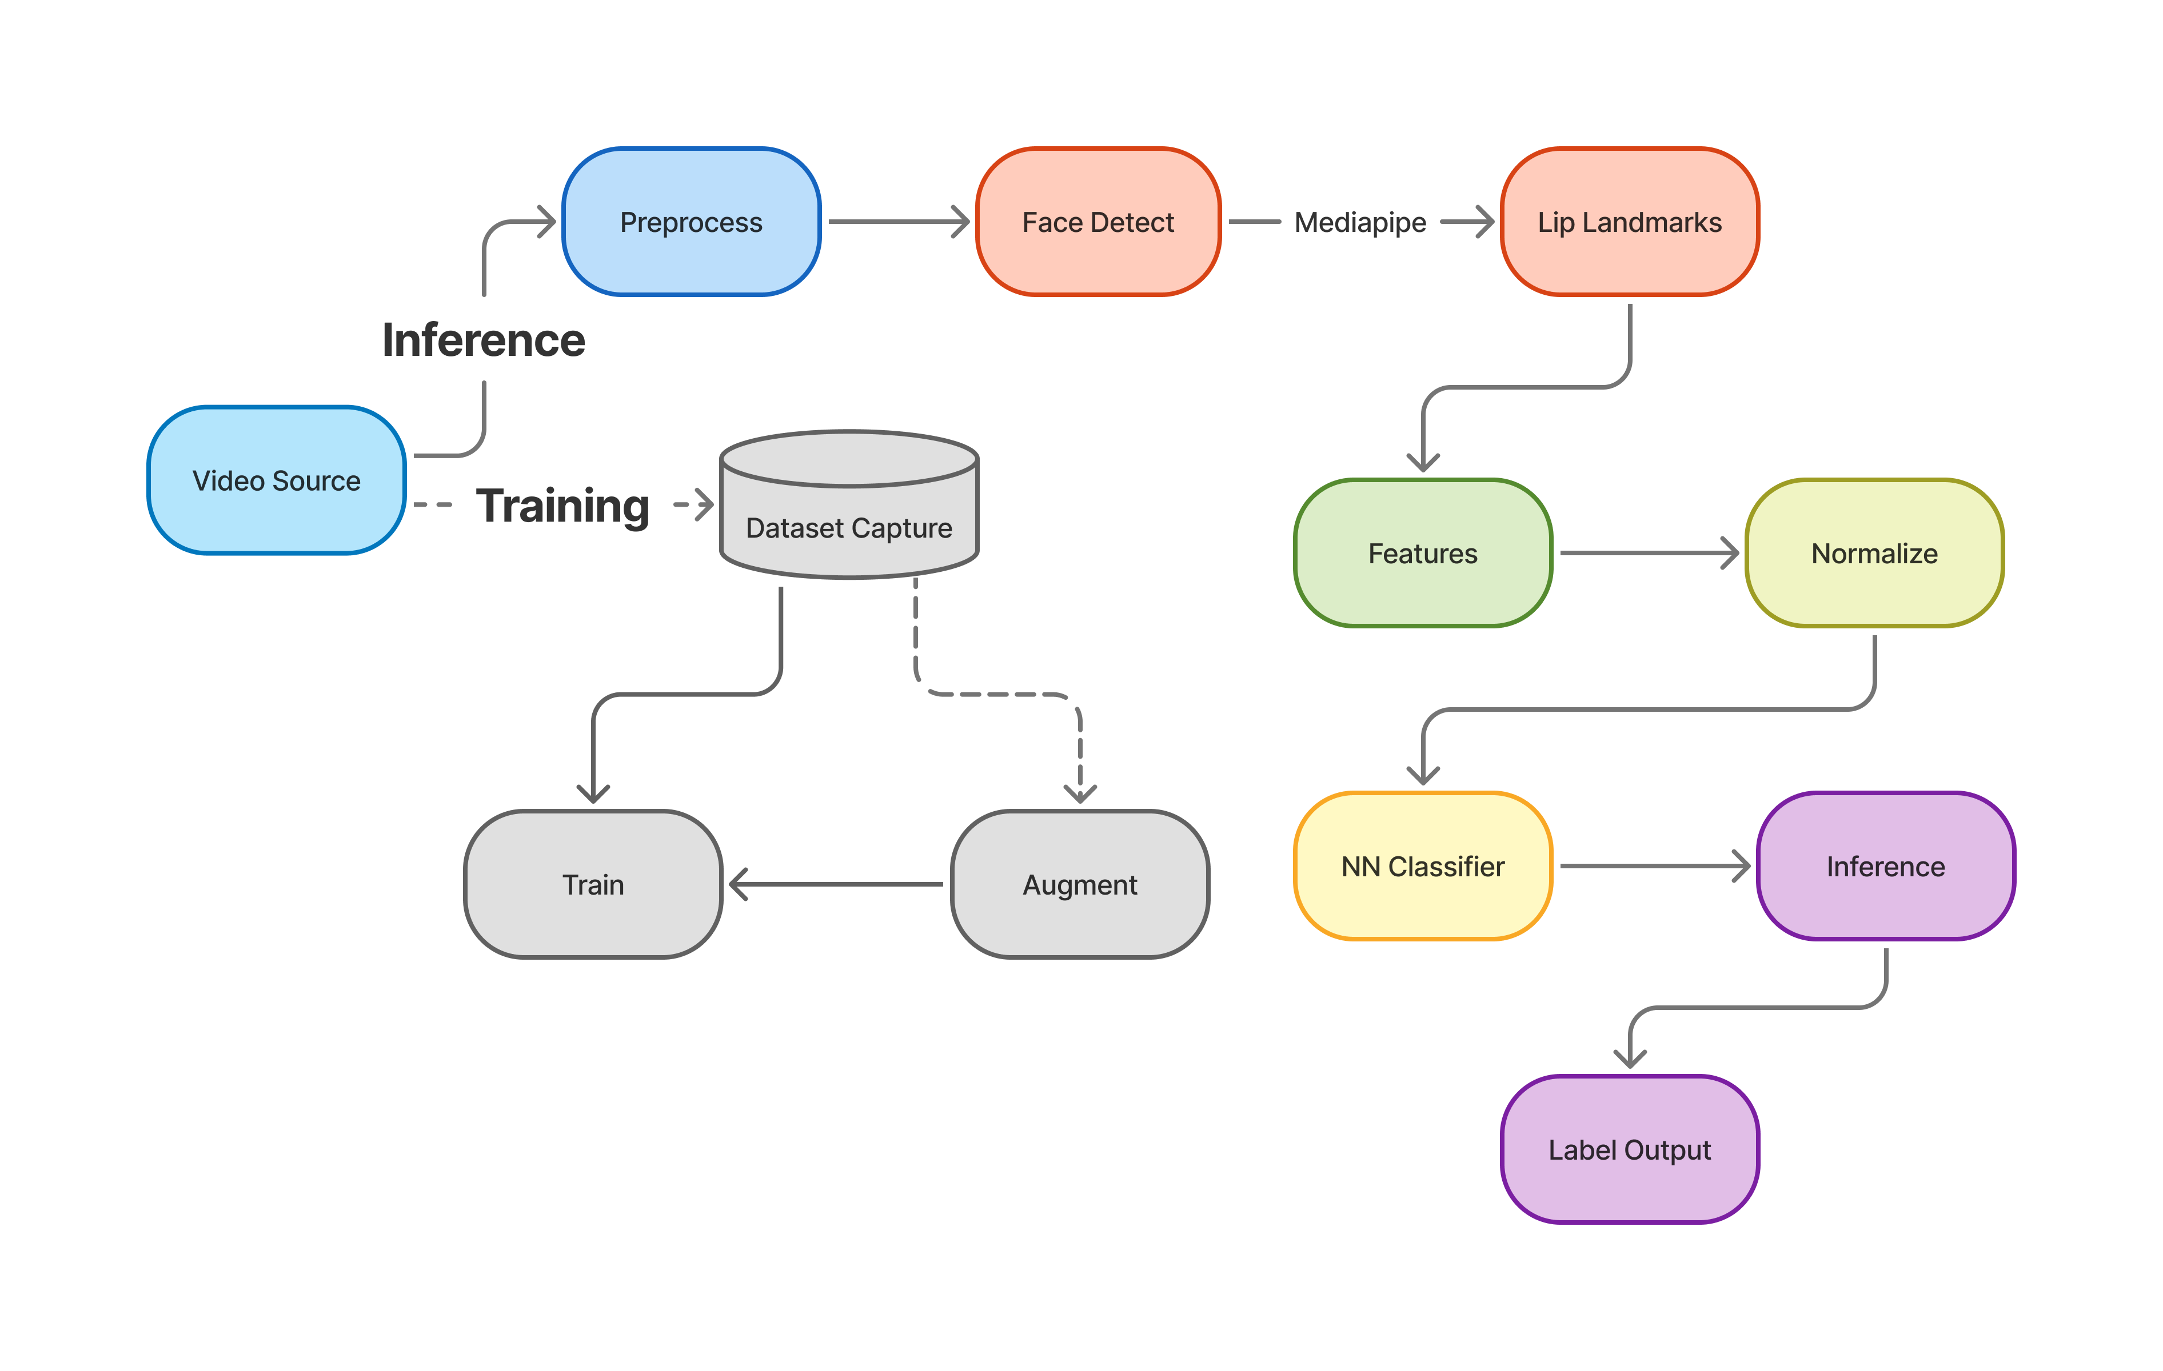
System Overview

Slide 4
Data & Labeling
Capture tool with hotkeys (t toggle label, r record, q quit)
Labels: 1 = talking, 0 = not talking.
Metadata CSV
Balancing: Optional mild augmentation for positives (flip + slight color jitter, capped to 2× positives).
Notes:
We collect data with a capture tool: t toggles the label, r starts or stops recording every Nth frame, and q quits. Labels are stored in a metadata CSV as filepath and label, with one for talking and zero for not talking. We apply only mild augmentation to talking frames and cap it to avoid overfitting.

Slide 5
Feature Design (Compact & Fast)
Geometry: MAR proxy, width/height, convex hull area, lip y-std.
Temporal: Smoothed frame-to-frame mouth movement (mean/std/max).
Pixel/edge: ROI mean/std, edge mean/std.
Distances & normalized keypoints for lip shape.
Normalization: StandardScaler fitted on train.
Notes:
Our features are compact and fast. Geometry includes mouth width and height, a MAR proxy, convex hull area, and lip vertical variation. Temporal features track smoothed mouth motion statistics. Pixel and edge features measure intensity and edge energy in the mouth region. Shape features include select inter-point distances and normalized lip keypoints. We apply a StandardScaler to balance the mixed units.

Slide 6

Model & Training
Architecture: ~38 → 12 (sigmoid) → 1 (sigmoid)
Loss: weighted BCE + L2; early stopping; pos_weight for recall
Stratified split; feature extraction per split; scaler fit on train
Config-driven runs; outputs model, scaler, history
Notes:
The model maps about thirty-eight inputs to a twelve-unit sigmoid hidden layer and a one-unit sigmoid output. Training uses weighted binary cross entropy with L2 regularization and early stopping, with a positive class weight to improve recall. We perform a stratified split, extract features per split, fit the scaler on training data, and run everything from a config file. We save the model, scaler, and training history.

Slide 7
Accuracy Improvements
Robust detection: Mediapipe default + OpenCV DNN + dlib/Haar fallback.
1
Class balance: Mild augmentation of positives (capped) + pos_weight in loss.
2
Threshold/smoothing tuning: Lower threshold (e.g., 0.4) and smaller smooth window to lift recall.
3
Clean data handling: Skip bad frames; normalize frame types; config for consistent runs.
4
Notes:
Speaker notes: “We improve accuracy through robust detection using Mediapipe by default and DNN, dlib, or Haar as fallbacks. We use class weighting and mild augmentation to offset class imbalance. We tune threshold and smoothing to boost recall by lowering the threshold and using a smaller smoothing window. We skip bad frames, normalize frame types, and keep feature scaling stable.

Slide 8
Results (Example)
Example test metrics (mediapipe backend): Accuracy ~0.89–0.94; Precision ~0.84–1.0; Recall ~0.67–0.89; F1 ~0.75–0.89 (tunable via threshold/pos_weight).
Inference speed: ~30+ fps on CPU with smoothing.
Demo note: Live webcam via python scripts/run_inference.py (defaults from config).
Notes:
Example test results with the Mediapipe backend show accuracy around zero point eight nine to zero point nine four, precision from zero point eight four to one point zero, recall from zero point six seven to zero point eight nine, and F1 from zero point seven five to zero point eight nine. Inference runs at over thirty frames per second on CPU with smoothing. A live demo runs with the inference script using config defaults.

Slide 9
Limitations & Next Steps
Limitations: Small dataset, recall sensitivity to threshold; pose/occlusion variance.
Next: Collect a bit more talking data, fine-tune threshold on a held-out set, explore light temporal models or per-speaker calibration.
Notes:
Limitations include a small dataset and recall sensitivity to threshold, pose, and occlusion. Next steps are to gather a modest amount of additional talking data, calibrate the threshold on a held-out set, and consider a lightweight temporal model or per-speaker calibration.

Slide 10
Takeaways & Evaluation Prompt
Takeaways: Compact feature set + lightweight NN achieves real-time talking detection; config-driven pipeline for repeatable runs; recall improved via class weighting and tuning.
Notes:
In summary, I built a real-time talking detector using compact features and a lightweight neural net. The pipeline is config-driven, and we lift recall with class weighting and tuning.

Slide 11
THANK YOU
QUESTIONS

